Slide 1
Website to Classroom
January 20, 2017

Slide 2
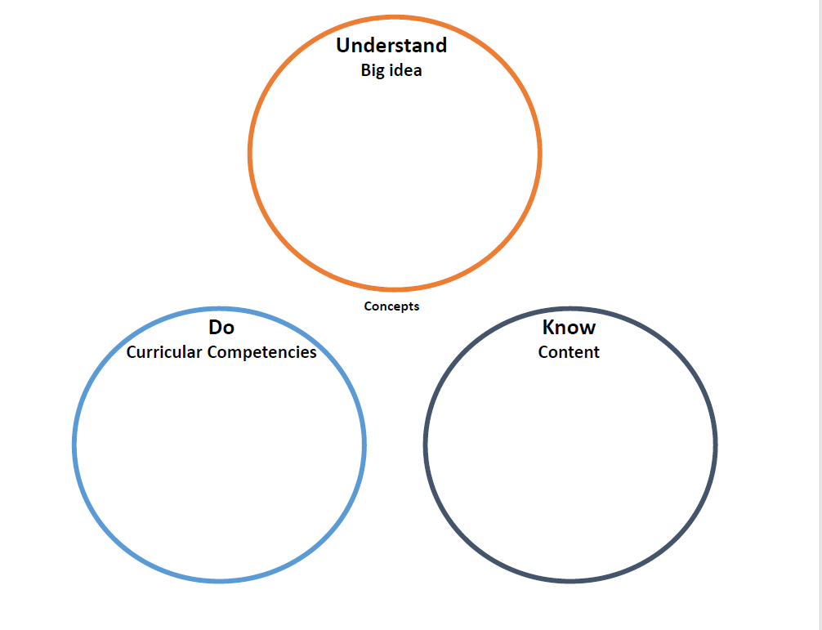
For this presentation…
Participants will need:
Laptop or other device to
access the internet
Print out of the KDU
planner (provided)
Notes:
It will be up to each FOS to decide how to handle the technology requirement.

Slide 3
Learning Targets
Participants will…
Navigate the Ministry of Education
website
Be introduced to, and begin planning with,
the KDU planner
Be guided in the beginning steps of extending their planning from the KDU Planner to the UBD Planner
Notes:
The first part of this presentation is designed to get you familiar with the ministry of education curriculum website. We will look at different points of access for the information in the website, the advantages to each, and give you an opportunity to explore the website yourself.
The next part of the presentation will focus on taking the information provided by the website and using it to start the planning process.We will be talking to you about a planning perspective that we are calling the "KDU" whose focus is centered on what we want students to know, do, and understand.
Finally, once you have had an opportunity to work with planning from a KDU perspective, we will give you a beginning look at how you can extend your planning from the KDU perspective into the district's Understanding by Design planner, aka the UBD planner.

Slide 4
Exploring the Curriculum Website
There are three main ways to access the curriculum on the ministry website:
Curriculum Search
Via fast links
Via the curriculum drop-down menu
Browse by Subject
Print the Learning Standards
Notes:
The ministry website is a valuable resource with a lot of information that teachers can use to help them in their planning. However, it can also be a difficult site to navigate if you are unfamiliar with it. Today, we're going to focus primarily on the different ways that you can explore the curriculum itself.
There are three main ways that you can access the curriculum on the website. The first is by using the "curriculum search” feature to look for specific topics or concepts within the curriculum. The second is using the "browse by subject" feature to view all the big ideas, content, and curricular competencies for a subject at a single grade level. The final method is to download and print the curriculum learning standards. This document will include all of the big ideas, content, and curricular competencies for a subject by grade level, but in a paper copy for those that find thatmedium more accessible.

Slide 5
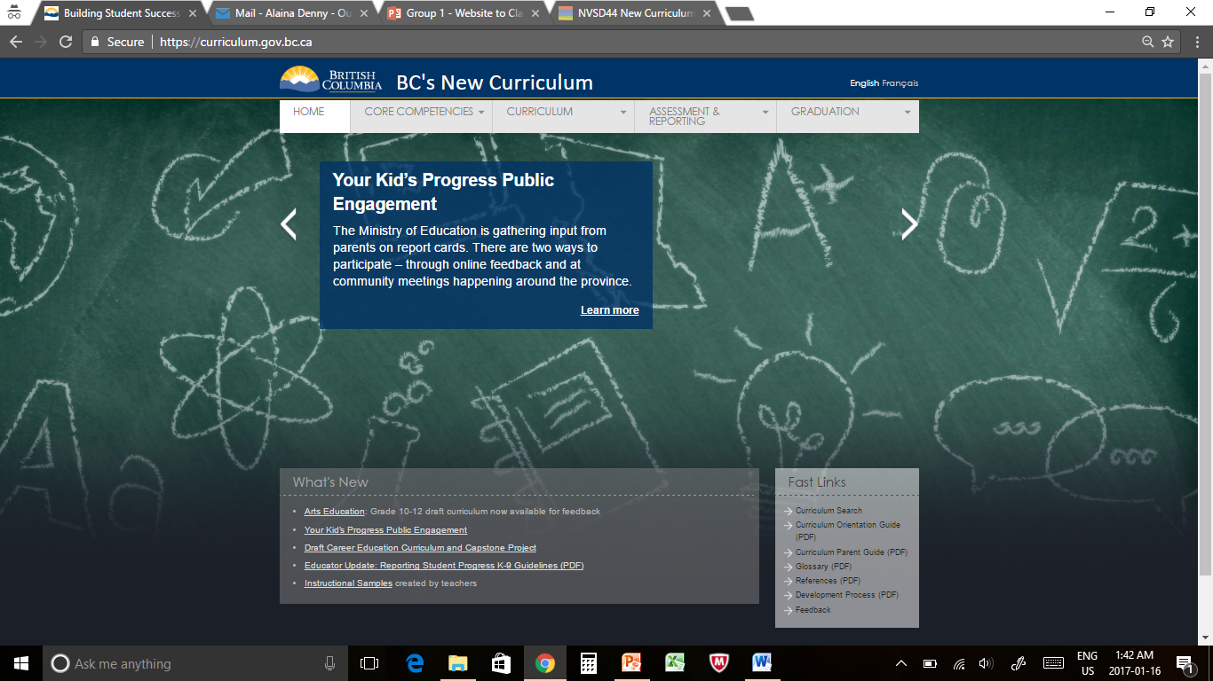
Option 1 of 3 – Curriculum Search
Accessing “Curriculum Search” via Fast Links
Notes:
On the bottom right corner of the main page, you will find a set of “fast links” which allow you to quickly navigate to various areas of the website. Today we are just going to look at the option of using this navigation tool to quickly access the curriculum search page.

Slide 6
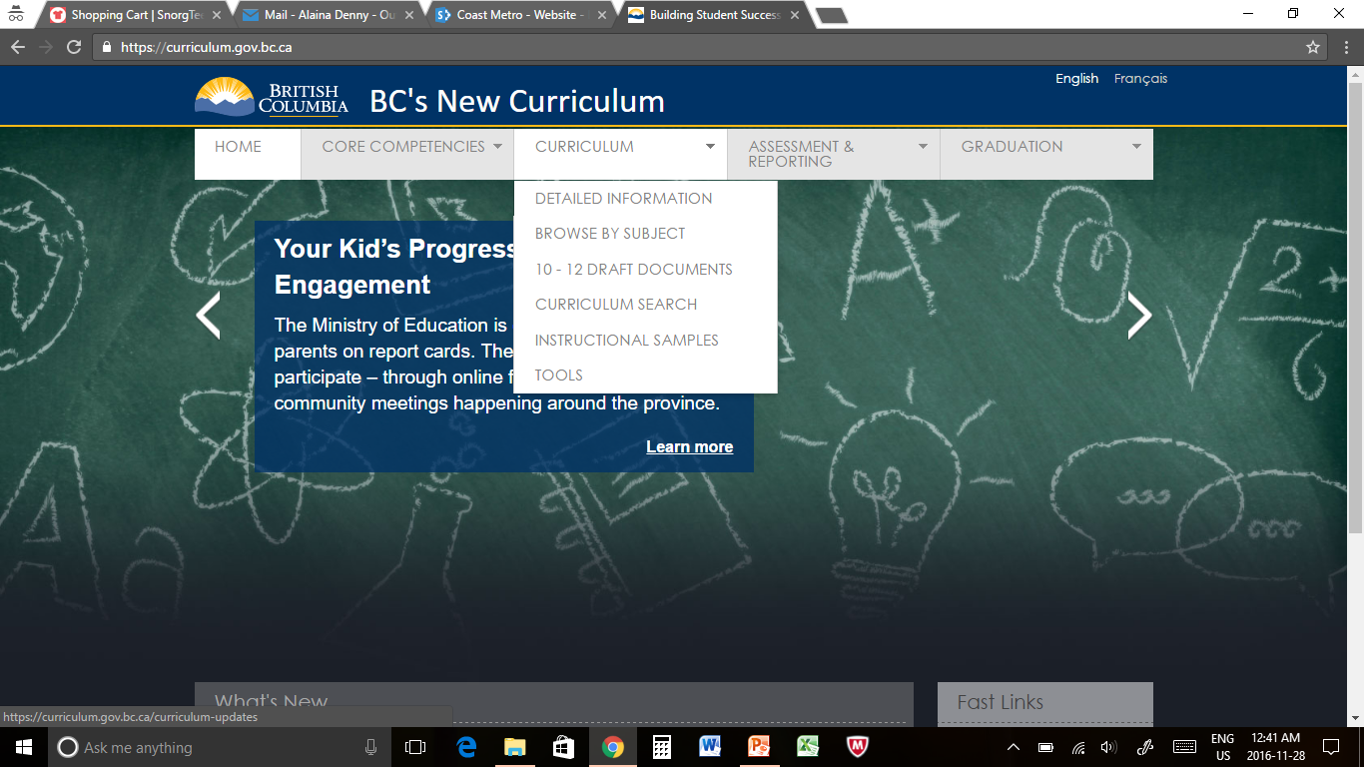
Option 1 of 3 – Curriculum Search
Accessing “Curriculum Search” via the drop-down menu
Notes:
You can also get to the curriculum search page by using the curriculum drop-down menu at the top of the page.

Slide 7
Option 1 of 3 – Curriculum Search
Search Page
Notes:
The search page is designed to let you customize your search parameters as broadly or narrowly as you’d like.
The curriculum search page can be an effective tool to help teachers identify the ways that prior learning experiences can be adapted to the revised curriculum. Using the key concepts from past learning experiences to set search parameters allows teachers to find the connections.

Slide 8
Option 1 of 3 – Curriculum Search
Select one or more curriculum areas to search
Notes:
The first step is to identify whether you are looking for big ideas, content, curricular competencies, or some combination of the three.

Slide 9
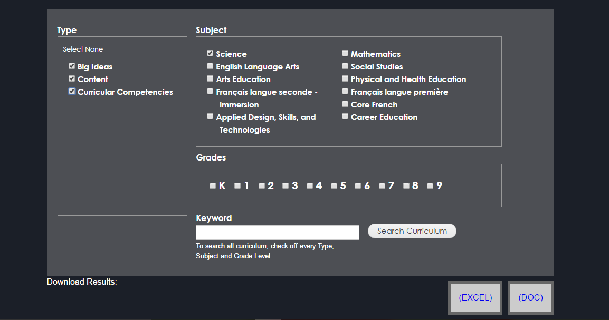
Option 1 of 3 – Curriculum Search
Select one or more subject areas to search
Notes:
Next, you need to identify the subject area you are looking in. You may choose as few or as many subject areas as you would like.
Choosing multiple subject areas, or even all subject areas, can allow you to find cross-curricular connections between big ideas, content, and curricular competencies.

Slide 10
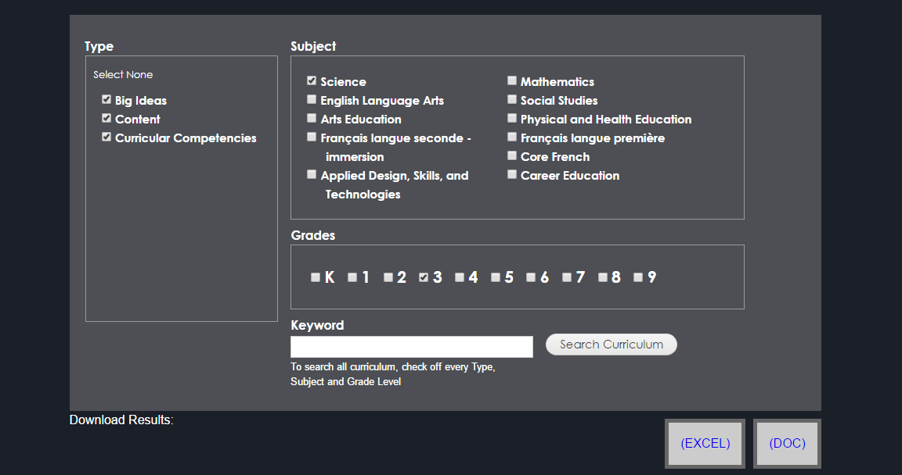
Option 1 of 3 – Curriculum Search
Select one or more grade levels to search
Notes:
You can then further narrow your search by selecting the grade level you are working with. Again, you may select as many or as few grade levels as you’d like.
Selecting multiple grade levels provides an opportunity for teachers working with combined grades, or who have students working with an adapted program at a different grade level, to identify curricular connections/themes between grades.

Slide 11
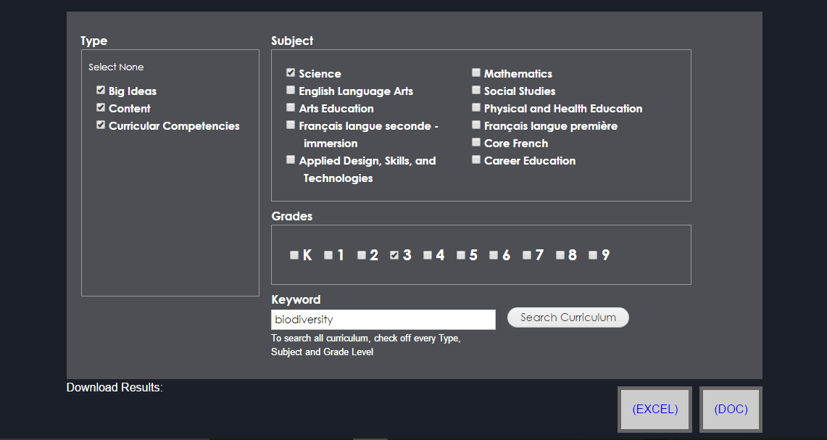
Option 1 of 3 – Curriculum Search
Use keywords to narrow the search parameters
Notes:
Using targeted keywords to narrow your search is the best way to find the specific cross-curricular and cross-grade connections you may be looking for.
Keywords can be anything, but they are most effective when they are the identified concepts you are planning to work with in a given unit.

Slide 12
Option 2 of 3 – Browse by Subject
Accessing “Browse by Subject” via the drop-down menu
Notes:
The second option to access the curriculum is to use the “browse by subject” feature. This feature will be found in the curriculum drop-down menu. Selecting it will take you to a page displaying each subject area with links to the curriculum for each grade below.

Slide 13
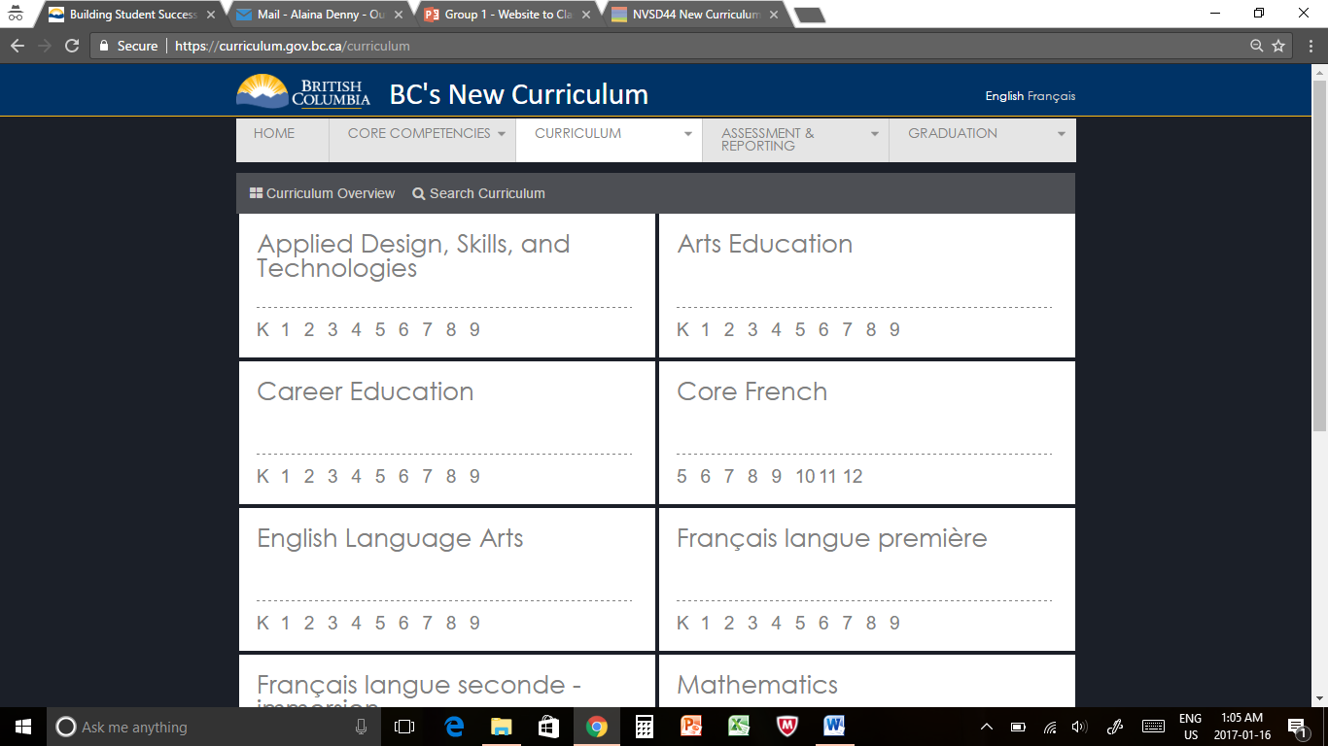
Option 2 of 3 – Browse by Subject
Search Page: Select the appropriate grade level and subject
Notes:
Once you have arrived at this page you simply need to select the grade you are working with under the appropriate subject section.
Curriculum search is helpful when teachers already have a starting point in mind in terms of a concept or specific learning experience, but are looking to solidify the curricular connections.
Browse by subject on the other hand is useful when teachers know what subject they are planning for, but may have decided little else. Using this feature they are able to look at the entire curriculum for a specific subject and grade to find inspiration for developing new learning experiences for their students.

Slide 14
Option 2 of 3 – Browse by Subject
Curriculum Page: Layout
Notes:
Selecting your grade from the subject area will take you to the curriculum page for that subject/grade, which will be laid out like this.
At the top of the page you will find the links to introductory materials and the core competencies, while at the bottom you will find links to supporting materials. The supporting materials include a link to instructional samples where you can search by subject and grade for lesson and unit plans that have been uploaded for your use. These samples can also be accessed using the curriculum drop-down menu.
The middle of the page is where you will find the big ideas, content, and curricular competencies. These are the sections that you will be using today to plan with the new curriculum.

Slide 15
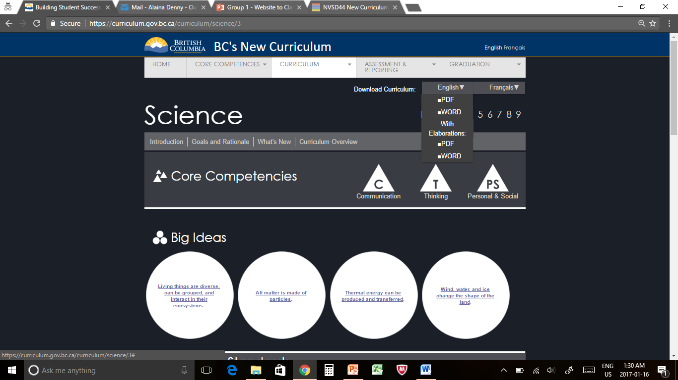
Option 3 of 3 – Printing the Curriculum
Printing the Learning Standards with or without elaborations
Notes:
If you prefer having a paper copy of the curriculum rather than viewing it online, you can also download the curriculum learning standards from the website.
In the upper right-hand corner of each curriculum page is a link to download the curriculum in either English or French. Clicking on either English or French will open a drop-down menu with options to download the curriculum learning standards in a PDF or Word document, with or without elaborations.

Slide 16
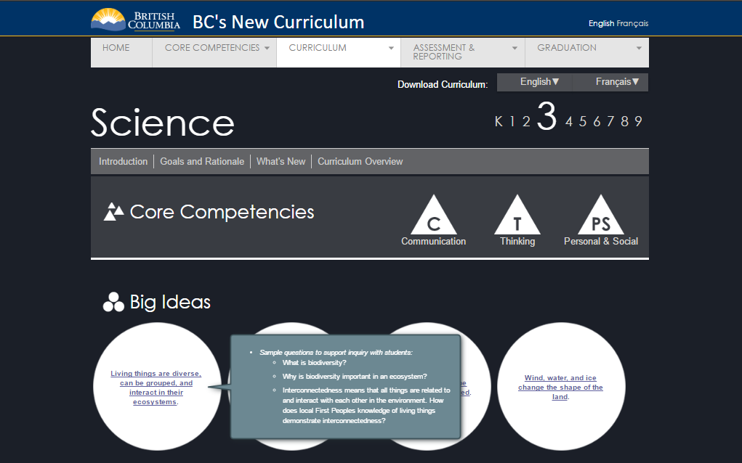
Option 3 of 3 – Printing the Curriculum
Printing the Learning Standards: What are elaborations?
Notes:
Elaborations are the extra information you find on the webpage by placing your cursor over underlined sections of the curriculum. This extra information may include inquiry questions, further details, and/or possible subtopics.

Slide 17
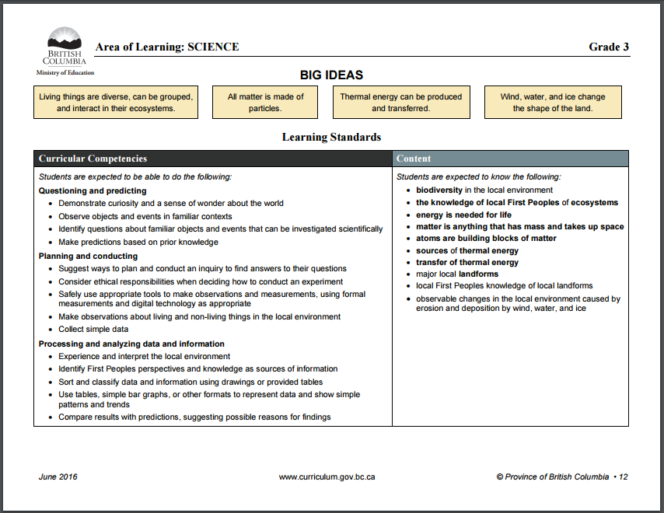
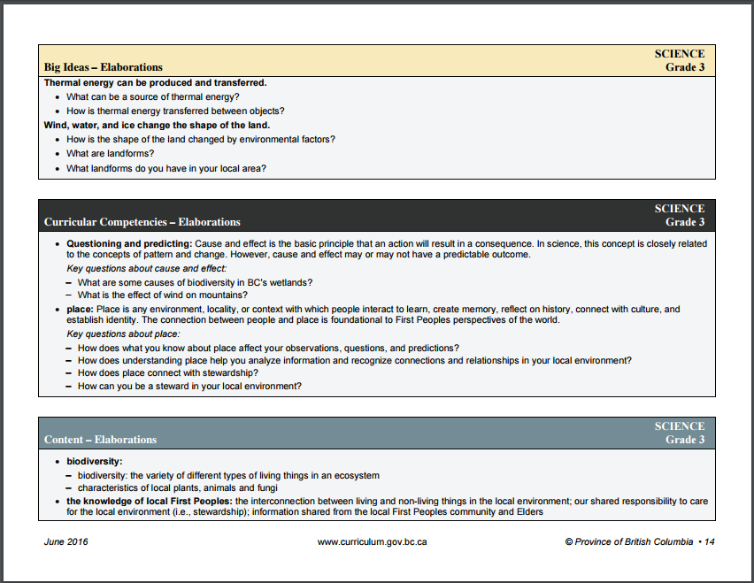
Option 3 of 3 – Printing the Curriculum
Printing the Learning Standards with or without elaborations
Notes:
Downloading the learning standards with elaborations will give you a document that looks like this. You can see that the learning standards appear first, with all the elaborations for each section appearing at the end on separate pages (downloading without elaborations will simply eliminate extra pages).
The document will have all the learning standards for that subject area from Kindergarten to Grade 9 included. You will need to scroll through the document to get to the pages for the grade you need.
Having a paper copy allows teachers to write or highlight directly onto the sheet. For some, this can be a beneficial form of preparation before attempting to work with the planner.

Slide 18
Exploring the Website
Now it’s your turn!
Using "Browse by Subject" and the curriculum page download a printable copy of the learning standards for Grade 5 Math with elaborations
Using "Browse by Subject" and the curriculum page find two content items from Grade 9 ELA that connect with the big idea “texts are socially, culturally, and historically constructed”
Using "Curriculum Search" find two subject areas that have cross-curricular connections to the concept of evolution
Using the "Instructional Samples" link find a sample math lesson
Notes:
We would like to give you an opportunity to explore the website yourself. To do that we are going to send you on a little scavenger hunt. Take the next five to ten minutes to find the items listed on the slide.

Slide 19
Next Step…
Using the website to plan for your classroom
Notes:
Now that you are familiar with the website we are going to introduce you to a planning perspective you can use in your classroom.
You may or may not have heard in your schools about the UBD planner, and you may or may not have attempted to use it. The planning perspective we are going to show you today is a stepping stone on the way to eventually using the UBD planner in your classroom.

Slide 20
The Curriculum Model
Notes:
Before going into detail about the planning perspective you will be working with today, we’d like to show you a short video from the Ministry of Education website introducing the Curriculum Model.

Slide 21
Planning: KDU Model
Big Ideas
(Understand)
Curricular Competencies (Do)
Content
(Know)
Notes:
Think of the KDU model as the bridge between the curriculum website to the district UBD planner. The circular design allows you to start at any point you feel comfortable, whether it is know, understand or do. KDUs are normally centred around a concept. Inputting your big ideas, curricular competencies and your content into the KDU Venn Diagram as a beginning stage can be useful in extracting the relevant information for a given unit or lesson.
K – these are the facts and knowledge you want the students to have.
D – these are the skills the students will utilize in conjunction with the facts to move towards establishing deeper understandings.
U – this is what we truly want the students to carry with them at the end of the unit or lesson to new situations and other content areas.

Slide 22
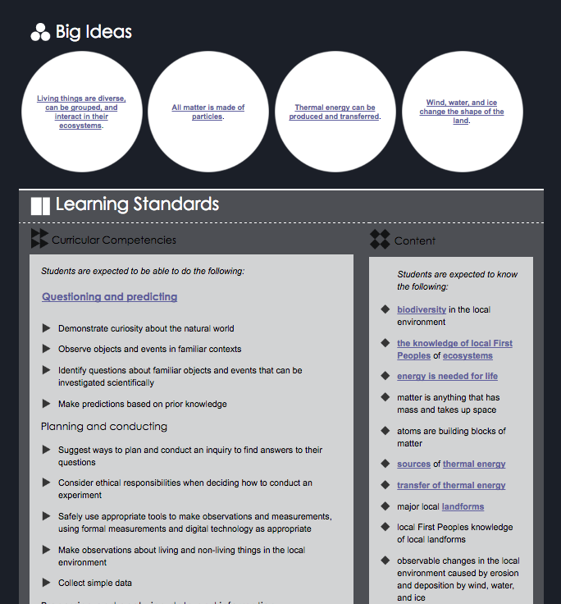
KDU Example – Content (K)
Notes:
To illustrate for you exactly how the information from the website would be placed into the KDU planner, we’re going to be looking at an example we’ve developed from the Grade 3 Science curriculum.
As we’ve mentioned, thanks to its circular design, you can begin by filling in the KDU model at any point you feel comfortable. For our example today, we’ll be starting with the "Know" section.
To fill in the “Know” section of the KDU planner we looked at the content area of the curriculum page and identified several related topics that we wanted our students to know at the end of our unit.

Slide 23
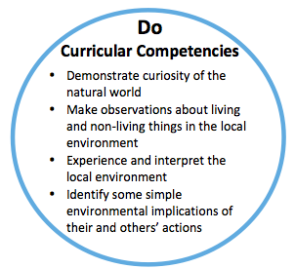
KDU Example - Curricular Competencies (D)
Notes:
After identifying what we wanted our students to know, we looked at what we wanted them to do.
To fill in the “Do” area of our planner we looked at the curricular competencies section of the curriculum page and chose several skills relevant to the topics selected in our first step.

Slide 24
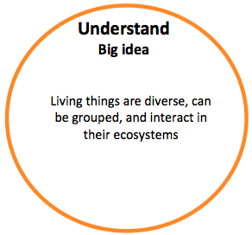
KDU Example - Big Ideas (U)
Notes:
After identifying what we wanted students to know and do the final step was to identify what, at the end of our unit, we wanted them to understand.
To fill in the “Understand” section of the KDU planner we looked at the big ideas on the curriculum page and chose the one best connected to the topics and skills we selected earlier in our planning.

Slide 25
KDU Example - Concepts
The following concepts were drawn from the big idea:
Living things
Diversity
Interactions
Notes:
The big ideas, content, and curricular competencies from a unit are generally centered around related concepts. Concepts are drawn from big ideas, and there are usually 2 or 3 main concepts that can be identified for a unit. For the purposes of our presentation, we will not be spending time looking at concepts and will be focusing on the KDUs instead. If you would like more information, the third presentation in this series focuses on concepts.

Slide 26
KDU Example – Grade 3
Notes:
Here you can see the completed KDU planner for the example we just.created.
This completed planner can be used as the basis for developing the learning experiences you will work on with your students. However, it can also be taken and developed further by using the district UBD planner.
We will be looking at how to extend from here into the UBD planner at the end of the presentation but before we get there we would like to give you some time to work with the KDU planner yourselves.

Slide 27
Exploring the KDU Planner
20 minutes…
Elementary teachers: work in grade groups using the Science curriculum
Secondary teachers: work in subject groups
Choose where you’d like to start (either the K, D, or U) and then fill in the entire planner
Notes:
You will have the next twenty minutes to work with the copies of the KDU planner that we have handed out to you.
We ask that Secondary teachers work in subject groups to fill out the planner, and that Elementary school teachers work in grade groups and fill it out using the Science curriculum for your grade.
Remember while you are filling out the planner that the KDUs you select must be related to each other in order to form the basis for a unit.
You will need to use the ministry website to access the curriculum page for your subject/grade. A reminder to everyone that you can do this by using the curriculum drop-down menu at the top of the page to access the browse by subject feature.

Slide 28
What’s Next?
Re-cap of what we know re: KDU
Taking it further?
Notes:
KDU stands for what you want students to Know, Do, and Understand. The KDUs are taken directly from the curriculum. The “Know” is the content, the “Do” is the curricular competencies, and the “Understand” is the big idea.
The KDUs can be used as the basis for your planning, but also as a basis for assessment purposes.
At some point you will find yourself comfortable with the KDU model and will probably start asking yourself “where can I go from here?”. You will reach a place where you’d like to flesh out your ideas a bit further and get really creative in your unit planning. That’s where the Understanding by Design, or UBD, approach comes in.

Slide 29
UBD – Understanding by Design
Notes:
Now we will show you a short video on Understanding by Design.

Slide 30
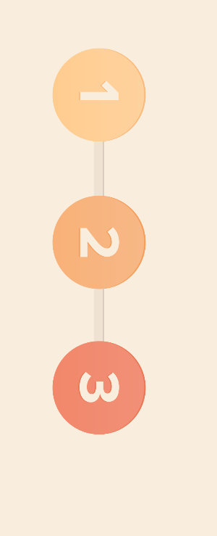
UBD – Understanding by Design
Stage 1: Desired Results (Big Ideas)
What do we want students to understand?
Stage 2: Evidence (Performance Tasks)
How will we know they understand? What will they do?
Stage 3: Learning Plan (Teaching Strategies)
How/what will we teach so they understand?
Notes:
There are three stages to Understanding by Design. You may also have heard this model of planning referred to as backwards design. This is because it is a planning model which starts with the end in mind.
The first stage is to identify what your desired results are. What is the understanding that you want students to reach?
The second stage is to identify how you will know if your students have reached the desired result and what they will do to show you that they have.
The third and final stage is to identify what you are going to do as a teacher to guide students to the understanding objective. What are the specific learning experiences you are going to provide them to get the students where you want them to go?
The curriculum is not “ready to go” off the shelf—it requires collaborative work to create the learning pathways to achieve the “Big Ideas”

Slide 31
Differentiation
Personalization
Teacher creates a learning plan for the students
Differentiation
Personalized learning
Notes:
This slide shows the different sections of the UBD planner. You can see that there is a different section for each of the stages in Understanding by Design.

Slide 32
The UBD Planner
Notes:
The UBD planner was created by NVSD teachers and has been in development for over a year. It is a working document that is continually being updated based on teachers' needs.
The KDUs you’ve been working with today are part of the UBD planner but they are not the entire picture. Starting with the KDU model is one way to ease teachers into planning with the UBD planner.
The KDUs fit into the first stage of the Understanding by Design model (desired results) and can be cut and pasted directly from the ministry website into the planner.

Slide 33
Content - Know
Notes:
The “Know” information from your planner would be placed in the content section of the UBD planner.

Slide 34
Curricular Competencies - Do
Notes:
The “Do” information from your KDU planner would be placed in the curricular competencies section of the UBD planner.

Slide 35
Big Idea - Understand
Notes:
The “Understand” information from the planner would be placed in the big idea section of the UBD planner with the concepts you’ve identified/pulled from the big idea placed underneath.
You can see from these slides that there is a direct correlation and transfer of information between the website, the KDU planner, and the UBD planner.

Slide 36
What's Next?
The KDU is a starting point for navigating the curriculum.
The next step is working more in depth with the UBD planner.
To do this, you can either attend the second session in this series or talk to your family of schools teacher or leader for more information.

Slide 37
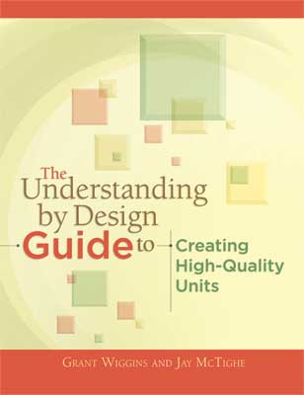
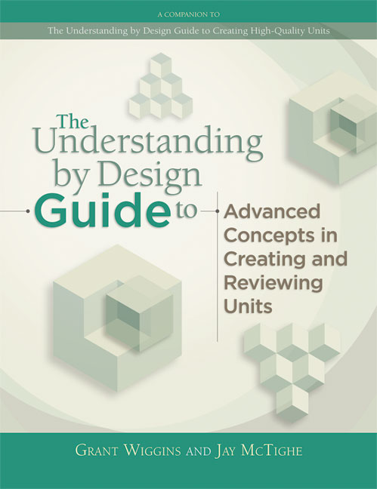
Resources
curriculum.gov.bc.ca
Jay McTighe: http://jaymctighe.com/resources/
Notes:
Here are some resources that you can access to continue your work with this.
The Ministry website is your best source for information on the revised curriculum and as we’ve seen it is also a source for instructional samples that you can use/adapt for your classroom.
Jay McTighe’s books on Understanding by Design are an excellent resource if you are looking for more information on the theory behind backwards design as a planning model.

Slide 38
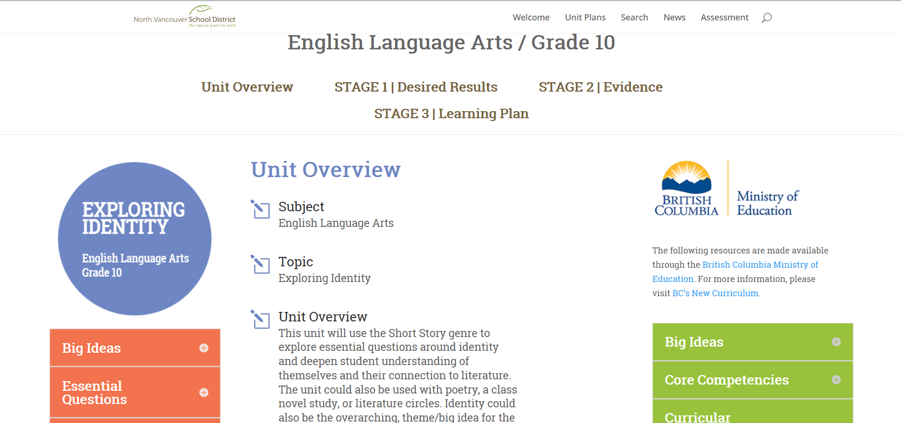
Resources – Curriculum Hub
http://nvsd44curriculumhub.ca/

Slide 39
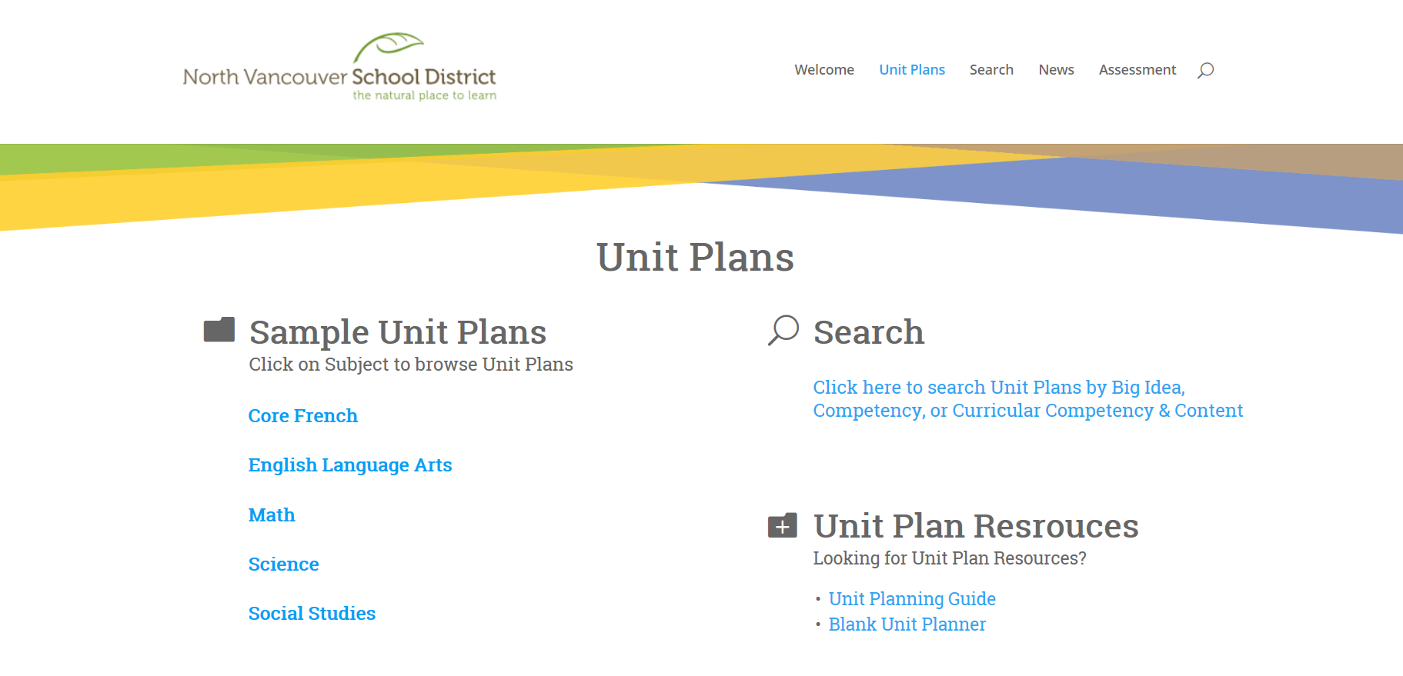
Resources – Curriculum Hub

Slide 40
Questions

