Slide 1
Considerations
Structure of “how” and “when” to share with staff (staff meeting/ collaboration time )
Structure of “where” and “when” students complete self-assessment
Access to devices and computer labs
Students requiring extra support
Absent students

Slide 2
Core Competencies: Summative Self-Assessment
Upload process 2019

Slide 3
May – What does it look like?
All students K-11 complete ONE Self-Assessment template
Students reflect on all THREE Core Competencies
Students choose the subject(s) to use for Self-Assessment
Students DO NOT have to reflect on all their subjects
Students submit evidence to support their claims

Slide 4
May–What does it look like?
Self-Assessment is electronic and stored in NVSD Scholantis Portal (NOT in G4)
Evidence is required for each student
Self-Assessment must be completed and uploaded to the portal by May 24

Slide 5
Portal Steps for Grades 4-7
Teacher creates class site
Student completes self-assessment "assignment"
Student submits self-assessment "assignment" and copies to Portfolio
Grades 4 -7
Student logs into portal
Teacher uploads Self-Assessment template as an "assignment"
Notes:
Overview of process for students grades 4-11.

Slide 6
Portal Steps for Grades K-3
Student completes paper or electronic self-assessment
Teacher photographs self-assessment or scans
Teacher logs into their class site and uploads photo or document into each student’s portfolio
Grades K-3
Teacher creates class site
Notes:
Overview of the process for K-3 students only. K-3 teachers may choose between this process and the one being used by 4-7 students.

Slide 7
Teachers “Choosing the Template”
Notes:
Process is the same for all classes K-7. If teachers have already created a class site, they do not need to create another to facilitate the completion of the SACC.

Slide 8
NVSD Curriculum Hub
Notes:
For the roll out of the New BC curriculum, our school district wanted to find a way to support teachers. In doing this, teams of teachers started working on unit plans with the new curriculum in mind and to share these unit plans, was born the curriculum hub.
With time, this hub started growing into quite a great space where teachers could find support in not only planning and units, but for core competencies support as well as anything curriculum development.

Slide 9
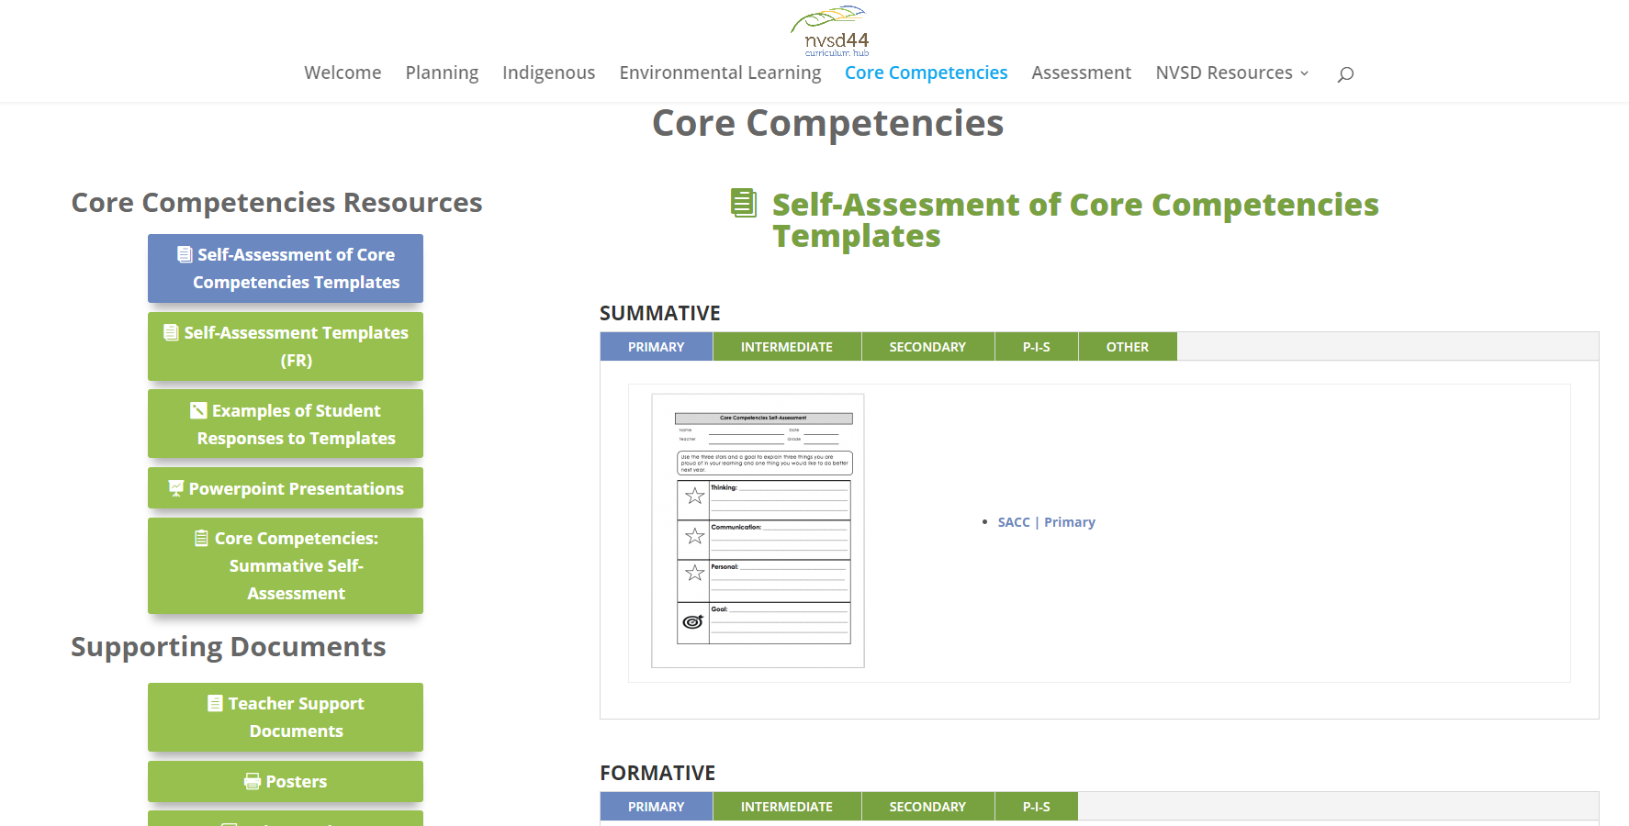
The Curriculum Hub
Notes:
On the HUB, you will find many different CC templates. They are in a developmental sequence and teachers aRE welcome to choose and modify any of the documents to suit their needs and their students.
All students will be able to complete a self-assessment and provide evidence of this. What this looks like for each student will be a little bit different, some students will require additional support e.g. EA support and evidence provided as part of the template can be varied.

Slide 10
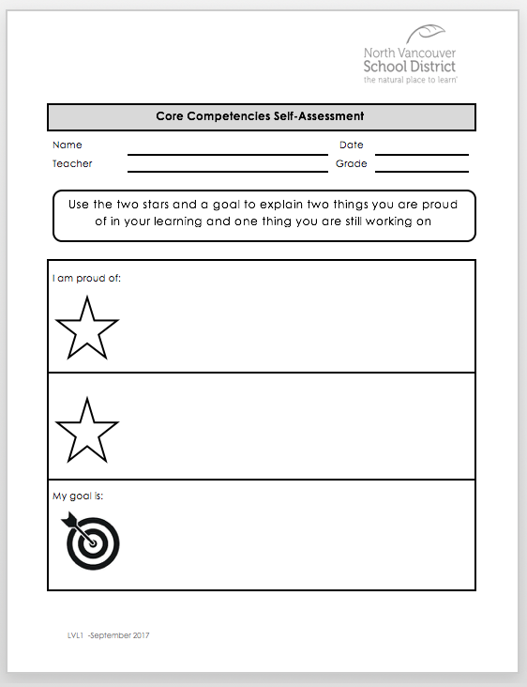
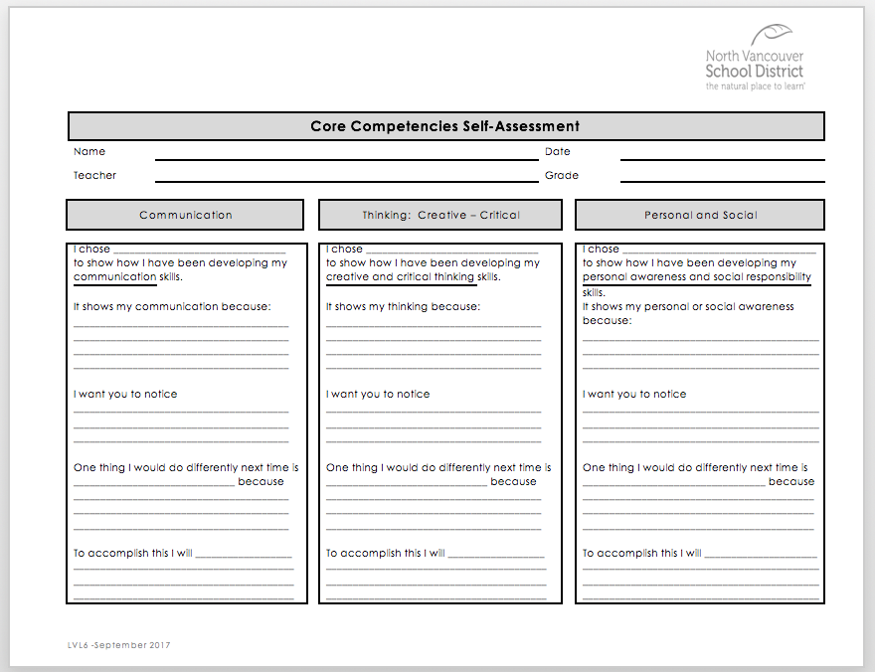
Summative Self-Assessment
Notes:
Sampling of the multiple templates available through the curriculum hub!!! All templates can be edited by teachers to meeting the needs of their learners

Slide 11
Download and Save Template
Save the chosen Summative SACC template to your computer with the file name “2019 SACC”
The consistent labeling of this document will be important for students to be able to search for and locate this file in future years
Notes:
Essential for file to labeled “2018 SACC” so that students will be able to easily locate this file for future reference. Teachers will need to save chosen template with this prior to uploading it for student completion.

Slide 12
Teachers “Creating a Class”
Notes:
Process is the same for all classes K-7. If teachers have already created a class site, they do not need to create another to facilitate the completion of the SACC.

Slide 13
Creating a Class Site

Slide 14
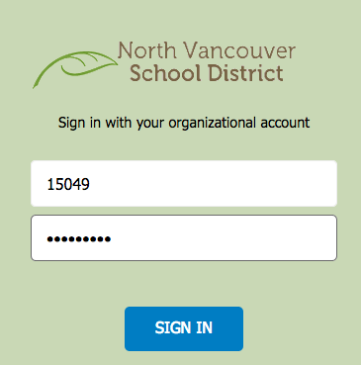
Log into the Portal
Enter your employee number and District password.
Click Sign In.

Slide 15
Click on “My NVSD”
Click My NVSD.

Slide 16
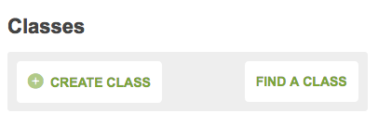
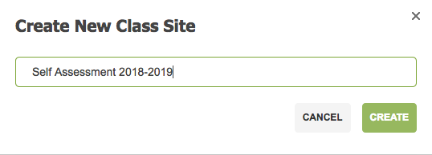
Click on “Create Class”
Click Create Class in the
Classes section on the left.
Enter the class name in the
pop up window.
Click Create.

Slide 17
Choose Logo and Theme Colour
All choices made for Logos, Themes, Features and Access may be changed at any time without loss of data.
Click Next.

Slide 18
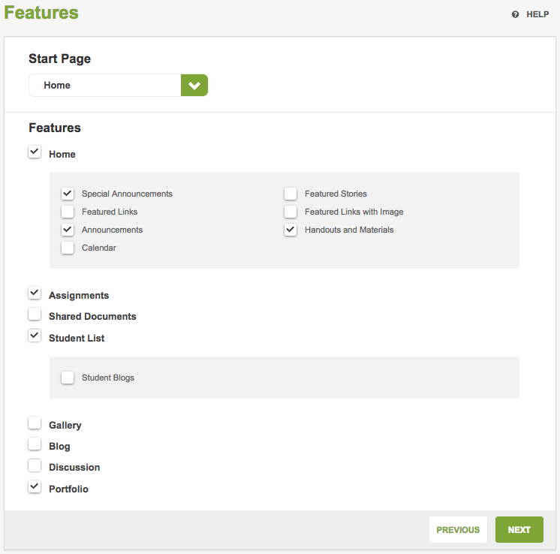
Choose Features
Add Features:
Assignments
Student List
Portfolio
Features may be added or removed at any time without losing data.
Start Page is the page that first opens for the viewer. It may be changed with the dropdown menu.

Slide 19
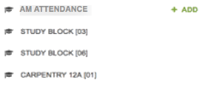
Adding a Class
Removing the “All Students” by clicking on the Remove button allows only students in your class to access the class site and not students district wide.
- If your class does not appear here, contact the ICT Service Desk.
If you job share, click on “Add Teacher” type the co-teacher’s name and click “+Add”.
Click “Finish” to save.
It will take from 45 seconds to 3 minutes to create your Class Site.
Notes:
Select AM or PM attendance to ensure that all students in a class are included. You can add other teachers or admin at anytime at this point.

Slide 20
Adding “Assignments” How to Upload 2019 SACC Template
Notes:
Process is the same for all classes K-7. If teachers have already created a class site, they do not need to create another to facilitate the completion of the SACC.

Slide 21
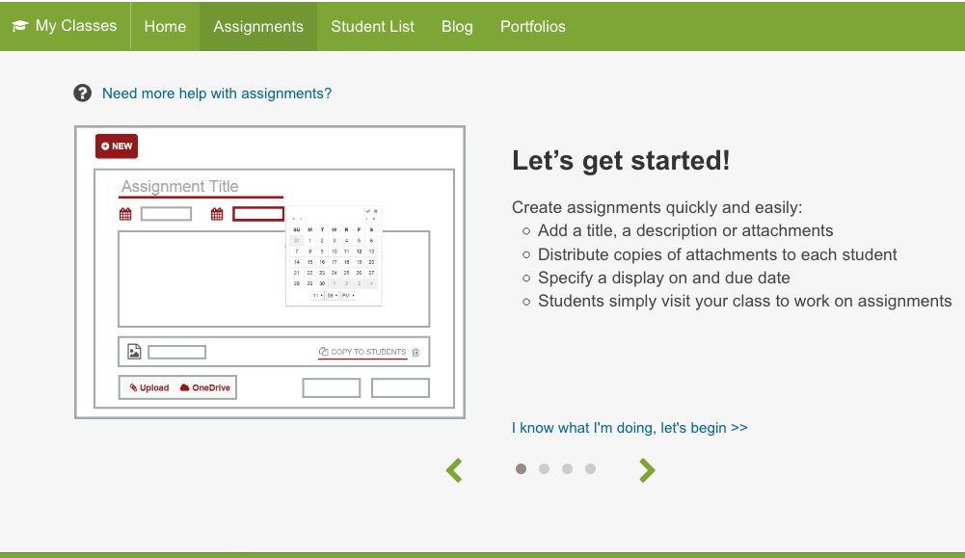
Click on “Assignments” top tab
On the Assignments page
click on “I know what I’m doing, let’s begin” in the blue text, to start.

Slide 22
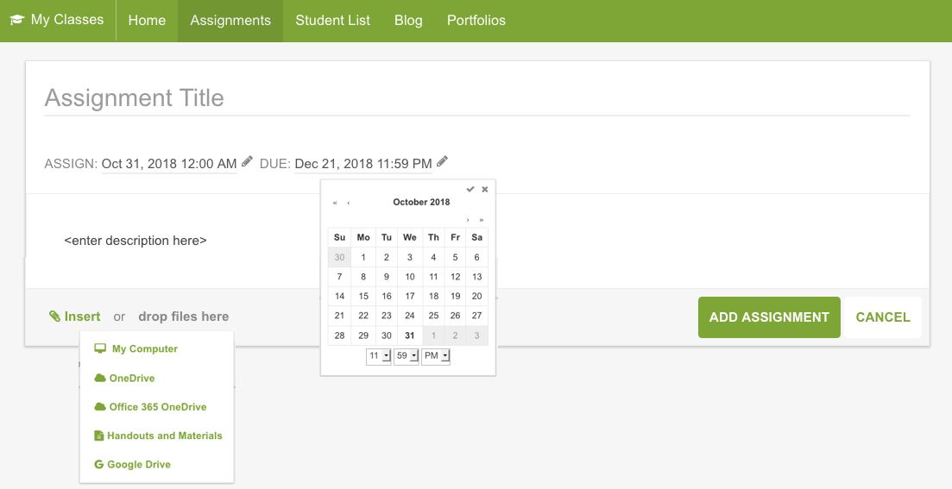
Add Assignment
Enter an assignment name
Set the due date
Enter description & instructions
Insert Assessment template
Notes:
Assignment date is when students will have access. Set due date as June 1, 2018.

Slide 23
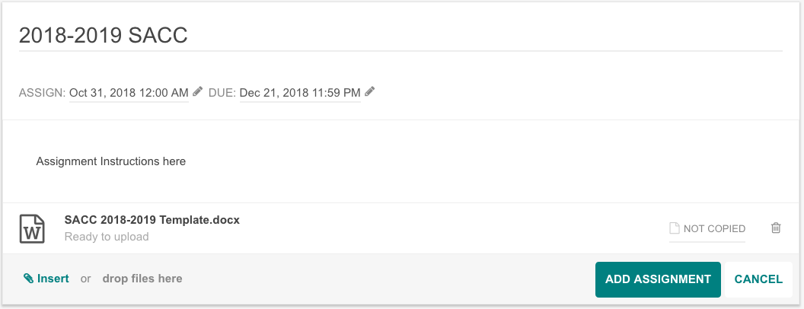
Copy Assignment to Students
Click Not Copied to copy the assignment to all
students.
Click Add Assignment

Slide 24
Viewing Student Submissions
Click Assignment title to view.
Click student’s name to expand.
Click attachment title to view or edit.
Enter a comment in the comment box.
Click Copy to Portfolio.

Slide 25
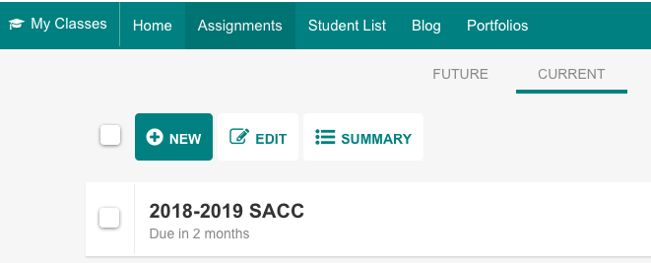
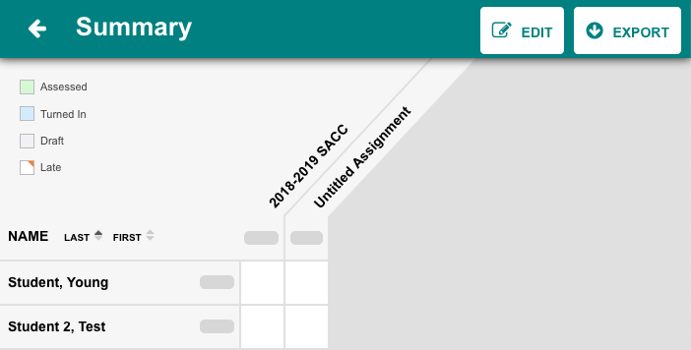
Viewing Submission Status
To see the class list showing students’ submission status, click on the Summary button on the Assignments Page.
This list may be exported to an Excel spreadsheet by clicking Export when the Summary is open.

Slide 26
Students Complete and Submit Self-Assessment
Grades 4-7
Notes:
Process is the same for Grades 4-7. Primary teachers have the option to have students complete SACC the same way as grades 4-7.
Student logins and passwords are available from admin assistants. Consider how students will have easy access to this information e.g. glued into agendas

Slide 27
Go to NVSD Website

Slide 28
Log into Portal

Slide 29
Log into Portal

Slide 30
Click on SACC Class
Notes:
E.g. Ms Reid’s Grade 5s or Division F06

Slide 31
How to Open 2019 SACC

Slide 32
Click “edit”
Notes:
Students do not need to download, upload or SACC as it will save automatically while they are working on it.

Slide 33
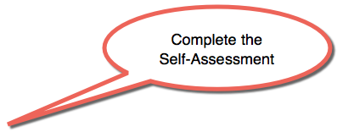
Complete SACC online

Slide 34
Click to close tab (saves automatically)

Slide 35
Click “Turn in” to submit

Slide 36
Click “Copy to Portfolio”

Slide 37
Click “Ok”

Slide 38
Upload Evidence to Portfolio
Click one of the add
Media options.

Slide 39
Upload Evidence to Portfolio
Enter a Post Title and select the
appropriate learning categories.
Add media and a description.
Click Submit to save and post.
Click X to return to Portfolio.

Slide 40
Sign Out

Slide 41
Student Self-Assessment Completion and Submission
Grades K-3
Notes:
Primary teachers have the option to have students complete SACC the same way as grades 4-7 or to have students complete their SACC on paper and then take a photo/scan etc and upload it directly to the student’s portfolios. Teachers are encouraged to consider what will work best for their learners e.g. Grade 2/3s who can complete electronically, buddy classes to assist etc.

Slide 42
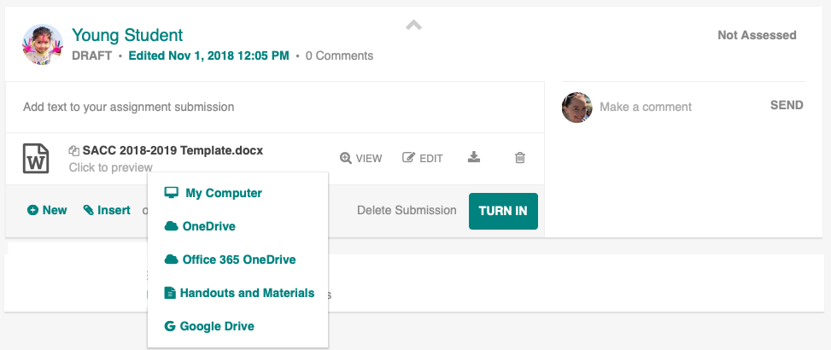
Paper alternative for K-3 students
Students complete SACC on paper and teacher uploads photocopy or scan of SACC to student portfolio
Notes:
Classes K-3 have the option to complete the SACC electronically (in the same way as students grades 4-7) or to complete it on paper and have the teacher will upload a photocopy or a scan copy of the students’ SACC to the portfolio.
If completed on paper there are two pathways to get SACC into student portfolios:
Through assignments (allows teachers to use summary function to track completion of SACC)
Upload directly to portfolio through each student individually (does not allow teachers to use summary function to track completion of SACC)

Slide 43
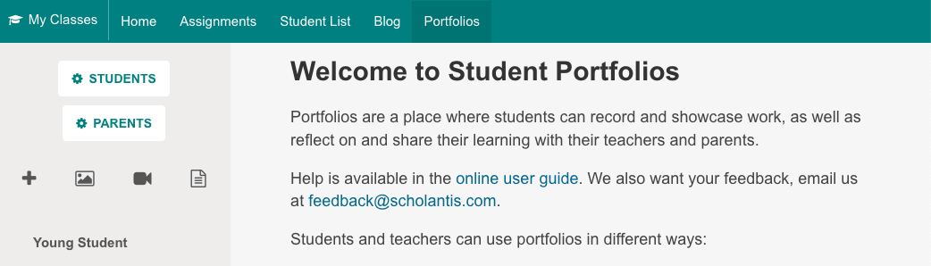
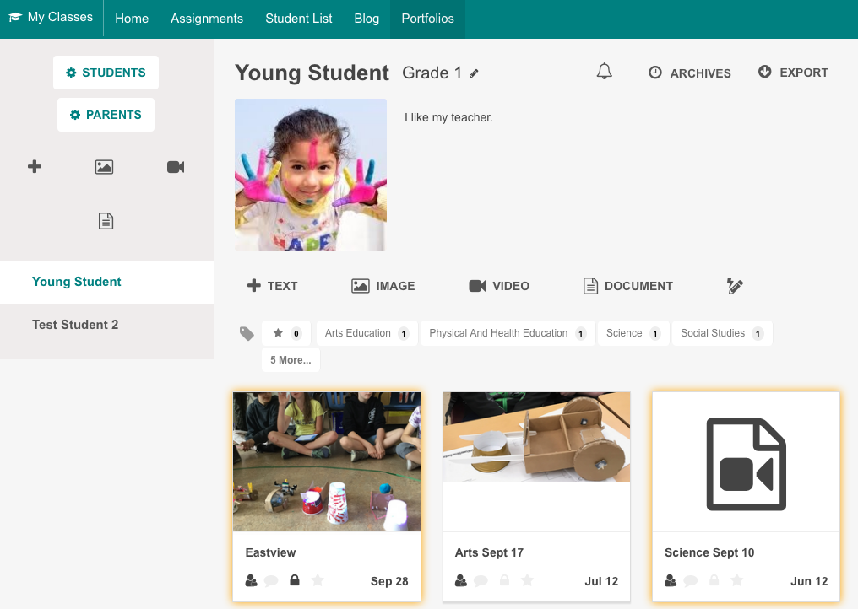
Upload directly to portfolio
Go to Portfolio top tab
Click student’s name on the left
Click one of the media options to add

Slide 44
Upload directly to portfolio
Modify date, add tags, upload media file and then click Submit.

