Slide 1
Core Competencies: Moving forward with Self-Assessment

Slide 2
Learning Targets
Integrate Core Competencies into the classroom
Develop students' ability to self-assess
Support student Self-Assessment of the Core Competencies
Notes:
Note: Current grade 8s have some of this language whereas grades 9-12 will require more explicit instruction to build awareness and understanding.

Slide 3
May–What does it look like?
Staff collaborate to chose a tool for Summative Self-Assessment
All students 8-12 complete ONE Self-Assessment tool
Students reflect on all three Core Competencies
Students need to represent their growth/strengths over the school year
Students may include a plan as to how to reach these goals
Students choose the subject(s) to use for Self-Assessment and the evidence
They DO NOT have to reflect on all their subjects
Notes:
Students will self-assess on all three Core Competencies across all subjects in May. They will upload one summative template that showcases reflection with evidence of how they situate themselves in relation to the Core Competencies.
School chooses a tool for Summative Self-Assessment
All students complete a Self-Assessment tool based upon their growth over the year
Student reflect on all three core competencies
Evidence should be shared with parents
Parents review the reflection

Slide 4
Integration of the Core Competencies
Notice it
Name it
Nurture it
Notice evidence of Core Competencies in student learning
Name specific facets and profiles of the Core Competencies
Nurture Core Competencies by moving forward along the continuum with instructional intention
Notes:
Review of Notice it, Name it, Nurture it
This is a continuum. We are at different places along this continuum.
We are moving towards the nurturing and development of the core competencies in our daily practice.

Slide 5
Notice it
Notes:
Posters are meant to act as a prompt for both the teacher and the students.
Teachers develop familiarity with and awareness of Core Competencies so they “notice” when students or they themselves are demonstrating an aspect of the Core Competencies
Teachers identify the Core Competencies in units and lessons they are already teaching
Teachers deliberately link the Core Competencies and the work to students during a classroom activity

Slide 6
Notice it: In my practice...
Notice it
Name it
Nurture it
How am I intentionally teaching & modelling the Core Competencies?
How am I developing student awareness of the language & goals?
Notes:
Reflect upon your practice
Focus on how you as a professional are developing your awareness of your own practice. Where do you notice that you are already integrating/teaching/modelling the Core Competencies?
Extension: Where do you notice students demonstrating aspects of the core competencies? When are they using the language? What connections do you see?

Slide 7
Name it
Notes:
Seek to standardize the language of the Core Competencies
Use the same language to describe the Core Competencies
Students should hear the same language from class to class
Teachers can develop the habit of modelling and identifying the Core Competencies in their current work
Point out to students the specific proficiencies being demonstrated

Slide 8
Name it: In my practice...
Notice it
Name it
Nurture it
How and when am I using the language of the Core Competencies in my practice?
Notes:
Model it, be specific in labelling it and draw connections to the CC.
Consider in planning how you can do this.
Ask students to identify when they notice aspects of the Core Competencies in themselves and others.
Unit planning?
Lesson planning?
Key visuals?

Slide 9
Nurture it
Posters slide
Notes:
Seek to standardize the language of the Core Competencies
Use the same language to describe the Core Competencies
Students should hear the same language from class to class
Teachers can develop the habit of modelling and identifying the Core Competencies in their current work
Plan for and facilitate meaningful opportunities for students to develop their understanding and self-assessment of the Core Competencies
Provide regular and ongoing feedback to students to support their development
Point out to students the specific proficiencies being demonstrated

Slide 10
Nurture it: In my practice...
Notice it
Name it
Nurture it
How and when am I using formative Self-Assessment in my practice?
Notes:
How and when am I using formative Self-Assessment opportunities to help my students identify their strengths and set goals for their development?

Slide 11
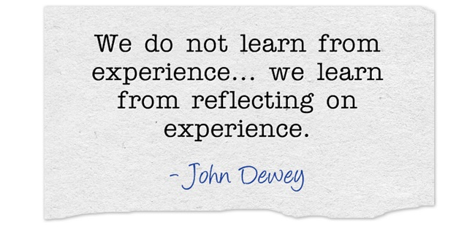
Nurture it

Slide 12
Nurture it: Self-Assessment
What is student Self-Assessment?
Self-Assessment requires students to engage in reflection, metacognition, and goal setting.
Notes:
Through reflective self-assessment, students:
–identify their own strengths
–see where to focus their attention in learning
–set realistic goals
–track their own progress
How can teachers foster self-assessment?
• Pose open ended questions about the process of learning
• Have students questions themselves:
Where am I now?
Where am I trying to go?
What do I need to do to get there?
How will I know I have accomplished my goal?

Slide 13
Nurture it: Self-Assessment
How do teachers foster reflection in our students?
“When it comes to helping students
develop core competencies,
the teacher’s role is more like a coach –
stretching & strengthening the core competency growth of their students.”
- Linda O’Reilly (2017)
Notes:
https://readingpowergear.wordpress.com/2017/04/30/guest-post-core-competencies-and-student-self-assessment-with-linda-oreilly/

Slide 14
Nurture it: Self-Assessment
Reflection is a habit teachers help foster!
Encourage reflective practice.
Model reflective thinking.
Notes:
https://readingpowergear.wordpress.com/2017/04/30/guest-post-core-competencies-and-student-self-assessment-with-linda-oreilly/
Students will eventually internalize the skill.
Plan for and invest time into:
Regular modelling and intentional teaching of the skills required for Self-Assessment
Encouraging ongoing and honest reflection
Providing opportunities to practice different aspects of the Self-Assessment process using clearly identified criteria
See the SD44 Curriculum Hub for ideas and strategies

Slide 15
Summative Self-Assessments
Notes:
Sampling of the multiple templates available through the curriculum hub!!!
Students need ongoing opportunities to self-assess and to receive feedback on their self-assessments. Self-assessments should be included as part of ongoing assessments with whole group and individual instruction to support their self-assessment skills and their understanding of the CC. Direct instruction around the CC should be integrated into lessons in an authentic way. Different aspects of self-assessment can be integrated on a regular basis to varying degrees and depths. Students should have had the opportunity to work with the templates prior to the completion of the summative self-assessment in May.
Explain why Self-Assessment is important
Honour that we all approach self-reflection differently
Address perceptions of Self-Assessment
Engage in discussions & activities focused on why Self-Assessment is important
Anticipate that students will respond differently to opportunities for Self-Assessment; some may welcome them, while others may question their worth

Slide 16
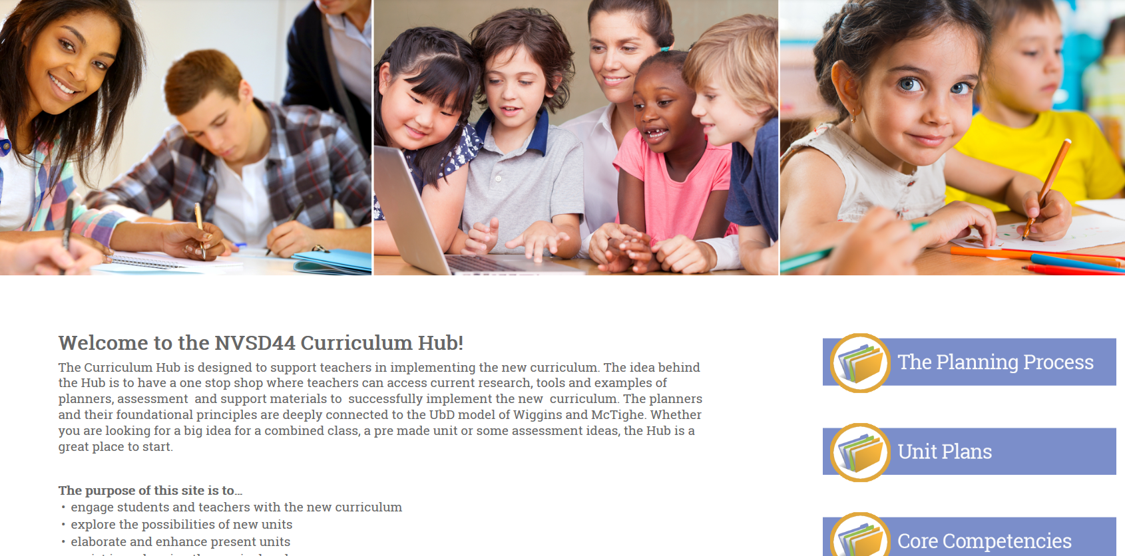
The Curriculum Hub

Slide 17
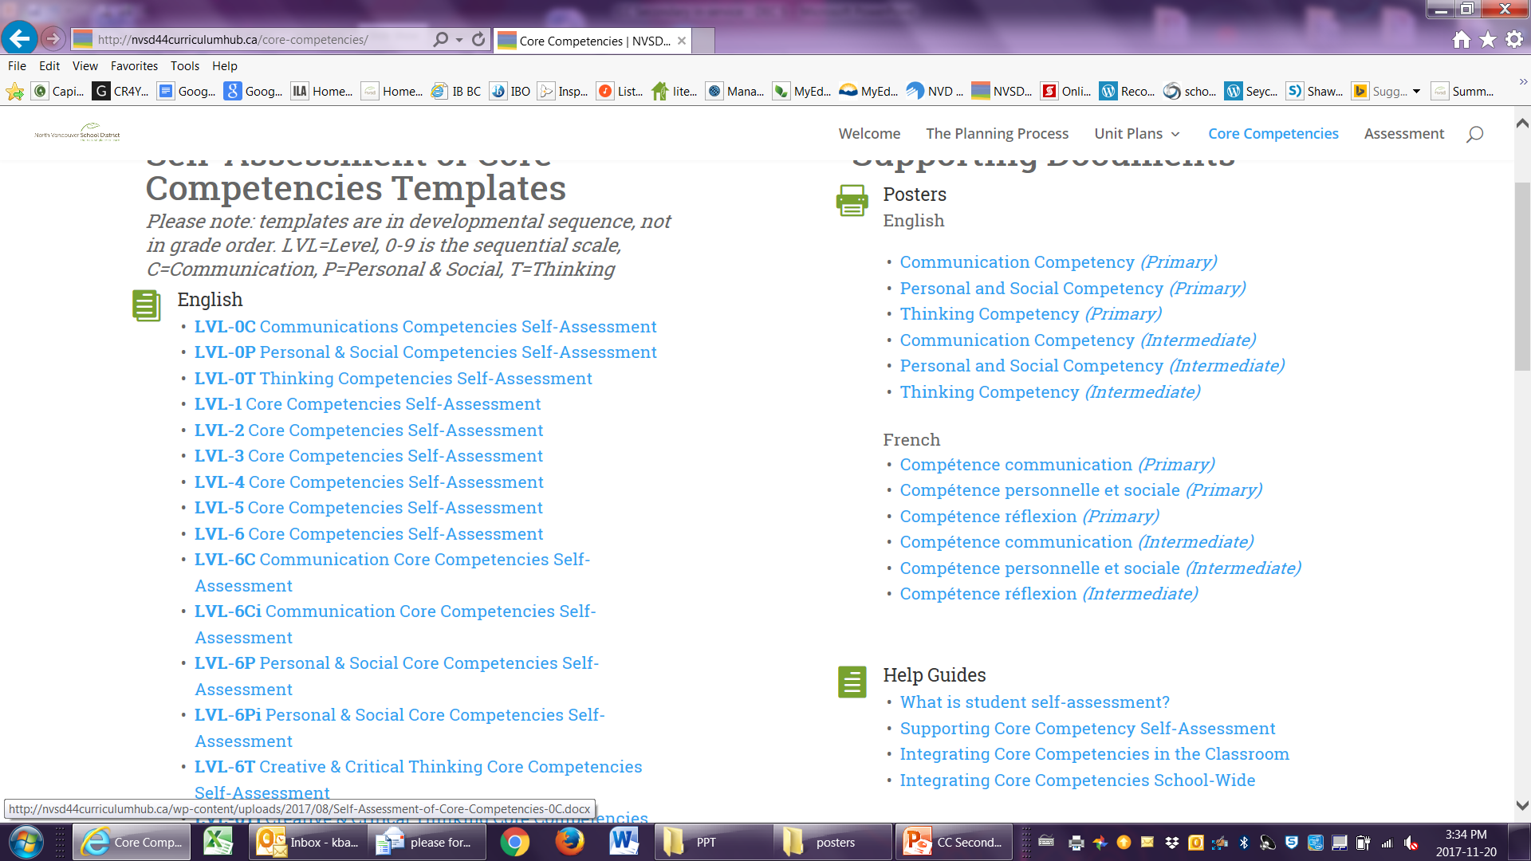
The Curriculum Hub
Notes:
On the HUB, you will find many different CC templates. They are in a developmental sequence and teachers aRE welcome to choose and modify any of the documents to suit their needs and their students.
All students will be able to complete a self-assessment and provide evidence of this. What this looks like for each student will be a little bit different, some students will require additional support e.g. EA support and evidence provided as part of the template can be varied.

Slide 18
The Curriculum Hub
Core Competency information on the Hub
http://nvsd44curriculumhub.ca/core-competencies/
Available:
Self-Assessment tools
Information sheets on teaching the Core Competencies and Self-Assessment
PPTs to share

Slide 19
Suggested Timeline
Month | Staff | Students
Fall | Explore the Curriculum Hub and the Core Competencies section Notice, and Name the Core Competencies Regularly reference posters | Notice, and Name the Core Competencies Use posters for reference
Winter | Discuss Core Competencies Self- Assessment tools Notice, and Name the Core Competencies Integrate Core Competencies throughout the Curriculum | Develop an awareness and understanding of the Core Competencies Introduce students to templates
Spring | Teach to (nurture) and practice (nurture) the Core Competencies and Self-Assessment | Practice (nurture) Self-Assessment of the Core Competencies using templates

Slide 20
Suggested Timeline
Month | Staff | Students
March | Staff collaboratively decide on Core Competencies Summative Assessment tool Notice, and Name the Core Competencies Integrate Core Competencies throughout the Curriculum Provide opportunities for evidence collection | Develop an awareness and understanding of the Core Competencies Notice, and Name the Core Competencies Collect evidence for Self-Assessment of the Core Competencies
April | Teach to (nurture) and practice (nurture) the Core Competencies and Self-Assessment Provide opportunities for evidence collection | Practice (nurture) the Self-Assessment of the Core Competencies

Slide 21
Suggested Timeline
Month | Staff | Students
May | Provide opportunities for evidence collection Teach to (nurture) and practice (nurture) the Core Competencies and Self-Assessment | Gather evidence Summative Self-Assessment of the Core Competencies
June | Upload Summative Self-Assessment Add comment to XSTU course to reflect Self-Assessment completed | Complete Summative Self-Assessment

